Slide 2
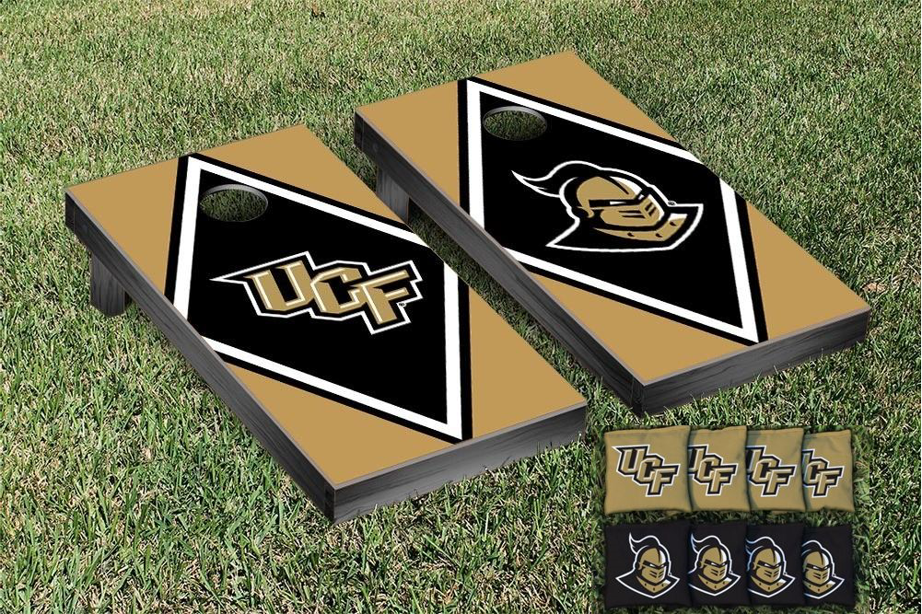
SMART CORNHOLE
BY:
FRANCISCO DE LA CRUZ - EE
GIOVANNI LARA - EE
NIHIL PATEL - EE
ALEX LAM - CPE

Slide 3
Introduction
Cornhole is a bean bag toss game that is regularly found at tailgating events, bars, or any fun social event.
The objective of the game is to alternate throwing sets of beanbags at a slanted game board.
Landing a beanbag on the game board counts as 1 point. A beanbag that lands in the hole of the board counts as 3 points.
First team to reach an exact score of 21 is deemed the winner.

Slide 4
Motivation
We want to improve the game by reducing cheating, eliminating arguments associated with scoring, and maintaining the overall fun environment that is usually associated with playing Cornhole.

Slide 5
Our Vision
Automatically score each round of bean bag tossing.
Accurately and immutably keep the score of each team.
Transmit the score wirelessly across the playing distance.
Display the score to all players and spectators.
Integrate a Bluetooth speaker setup.
Drink Holders and bottle openers for utility.

Slide 6
The “Console”
We decided not to build two game boards for a traditional Cornhole setup.
Limited by budget (mainly, the cost of another RFID reader).
Two game boards would effectively double the cost to the consumer.
Instead, we will build a console that serves as proof of concept for a second gameboard.
Placed next to the beanbag toss point.
Has a physical push button that ends a round of the game.
Has it’s own battery, MCU, and communicates wirelessly with game board.

Slide 7
Specifications
Score Detection
M6E Nano RFID Reader should provide an accurate reading of a three-point throw and One point throw based on signal strength.
Score Display
7 segment display should be readable from 10 meters away.
Power Supply / Battery
Should be rechargeable and last for up to 8 hours of gametime.
Speakers
Should be Bluetooth capable with speakers featuring 3-inch drivers.

Slide 8
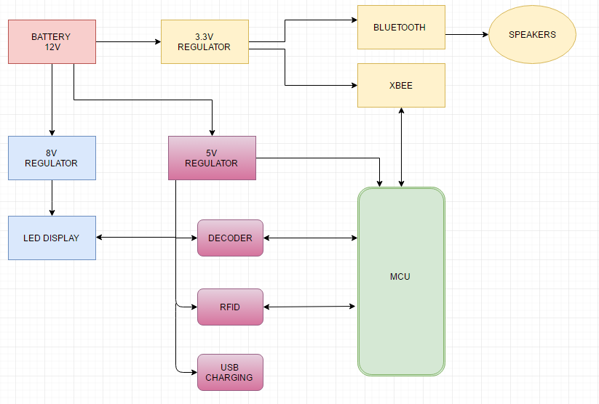
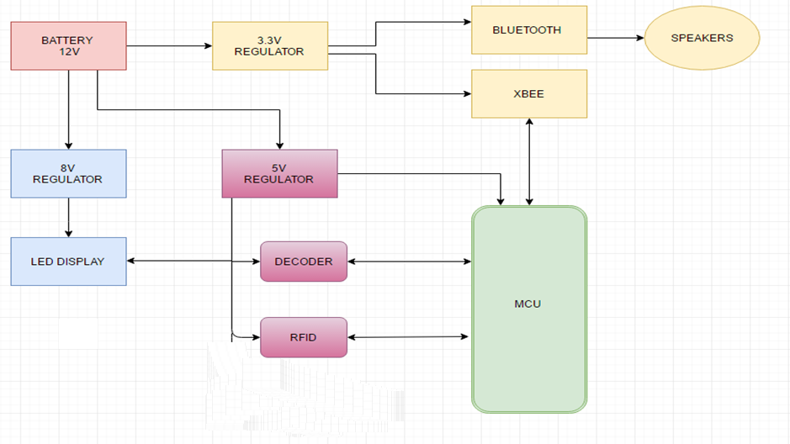
Overall Block Diagram

Slide 9
Power System
12V
Battery
5V
Regulator
8V
Regulator
3.3V
Regulator
MCU
RFID
Reader
BCD
Decoder
LED
Displays
Xbee
Module
Bluetooth
Module

Slide 10
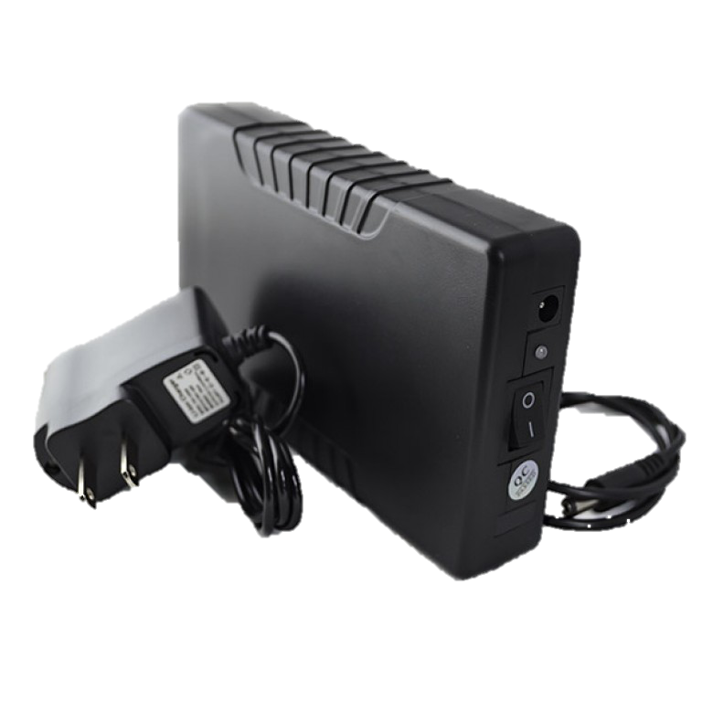
The Battery
HitLights Lithium-Ion Battery
12V Rechargeable Battery
3500 mAh capacity
Plastic housing for durability
Output overload protection
Tenergy Lithum-Ion Battery
11.1V Rechargeable
2200 mAh capacity
No plastic housing
Output overload protection
3.93 inches
2.36 inches

Slide 11
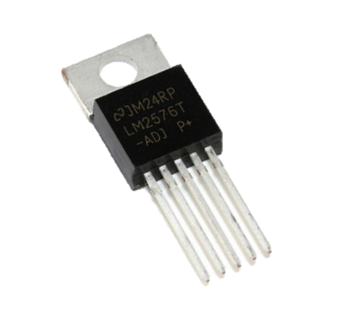
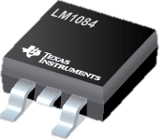
Voltage Regulator
LM2576
High Efficiency
Switching voltage Regulator
Adjustability between 1.23 – 37V
52kHz Oscillator Frequency
LM1084
Low Dropout Voltage (Maximum of 1.5V)
Linear Voltage Regulator
Adjustability between 1.2V – 15V
12 mm
10 mm

Slide 12
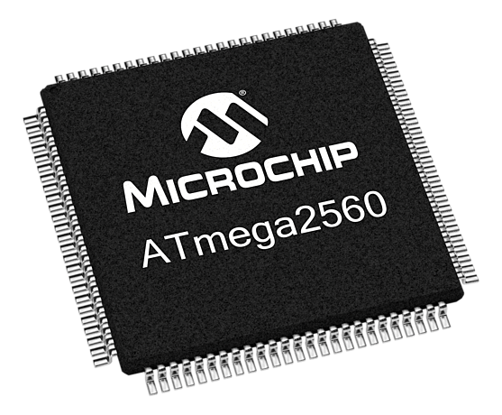
Microcontroller Unit (MCU)
ATMEGA 2560 By Comparison:
Program memory: 256KB Atmega328 (Arduino Uno)
RAM: 8KB RAM: 2KB
PIN Count: 100 PIN Count: 26
Operating Range: 4.5 – 5.5V
16 mm by 16mm

Slide 13
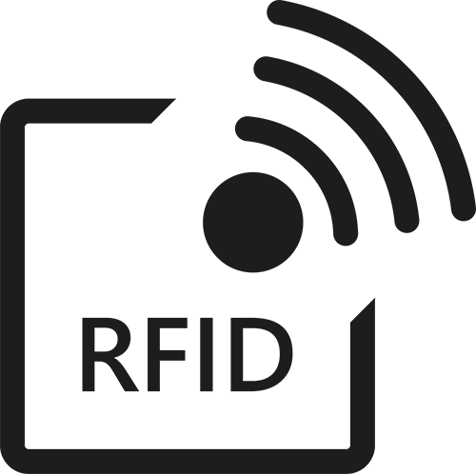
Radio Frequency Identification (RFID)
A way to achieve our goal is by using RFID technology which well allow us to wirelessly monitor the score.
That will be achieved by adding tags inside each bean bag which will indicate the score once they pass the RFID sensor.

Slide 14
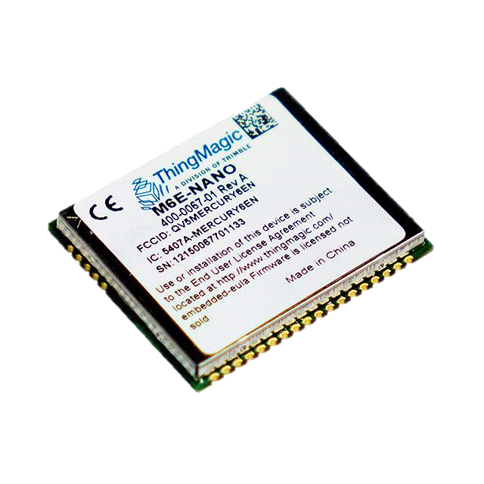
Radio Frequency Identifation (RFID)
After researching, the group decided on the M6E Nano Module:
Ultra High Frequency RFID
Can read up to 150 tags per second.
Supports EPCglobal Gen 2 tags.
Has separate read and write levels that can be adjusted.
26 mm
22 mm

Slide 15
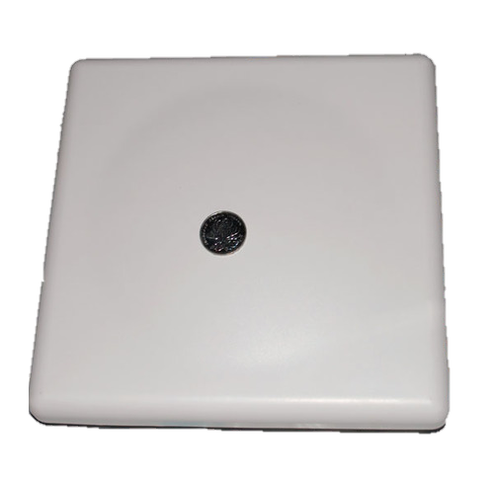
Antenna
LinkSprite UHF RFID Reader
Read Frequency of 902-928MHz
8dBi Gain
Easily Mountable
216 mm
216 mm
Antenna | Cost
LinkSprite UHF RFID Reader | $80.00
UHF RFID Antenna (TNC) WRL-14131 | $34.95

Slide 16
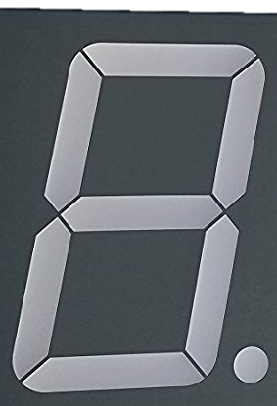
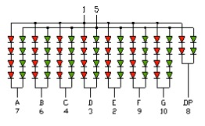
ChromeLED 7-Segment Display
Four LED 7-segment Displays will be used to display both teams points
Two different colors: Red, and Green
Readable from up to 10 meters
Bright enough to be visible on a sunny day
Common Anode
2.75 inches
1.90 inches

Slide 17
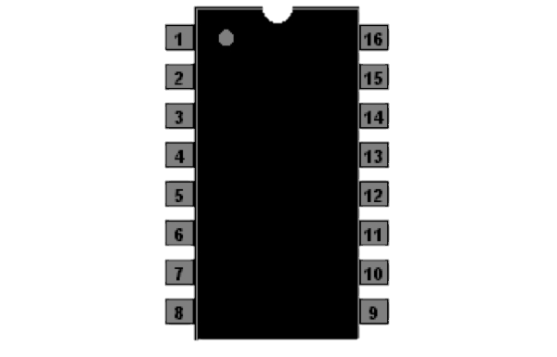
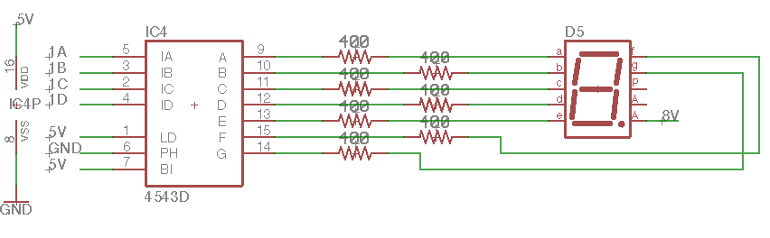
BCD Decoder
CD4543B
4 inputs and 8 outputs
Reduces number of digital pins used in the MCU
Translates binary to corresponding decimal number
Simplifies software coding
20 mm

Slide 18
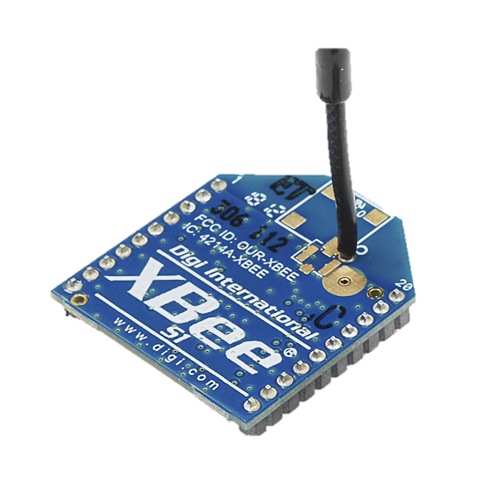
ZibBee Wireless Communication
IEEE 802.15.4
Low power Consumption
Range 10-100 meters
3.3V 50mA
250 kbps Max data Rate
WHY XBEE?
XBEE Series 1 | >100 meters | $20
RN 131 Microchip | ~100 meters | $40
XBEE Series 2 | >120 meters | $30

Slide 19
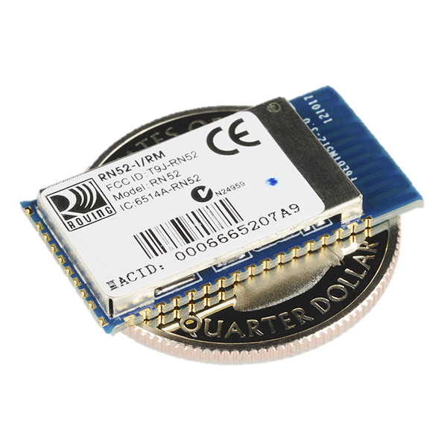
RN-52 Bluetooth Module
Easy to configure module
Allows wireless audio streaming through Bluetooth connection
Can function as stand alone or with a MCU
Bluetooth v3.0
Wireless range of 10 meters
11 general purpose I/O pins
RN 52 | $17.25
WT 32 Silicon Labs | $25.71

Slide 20
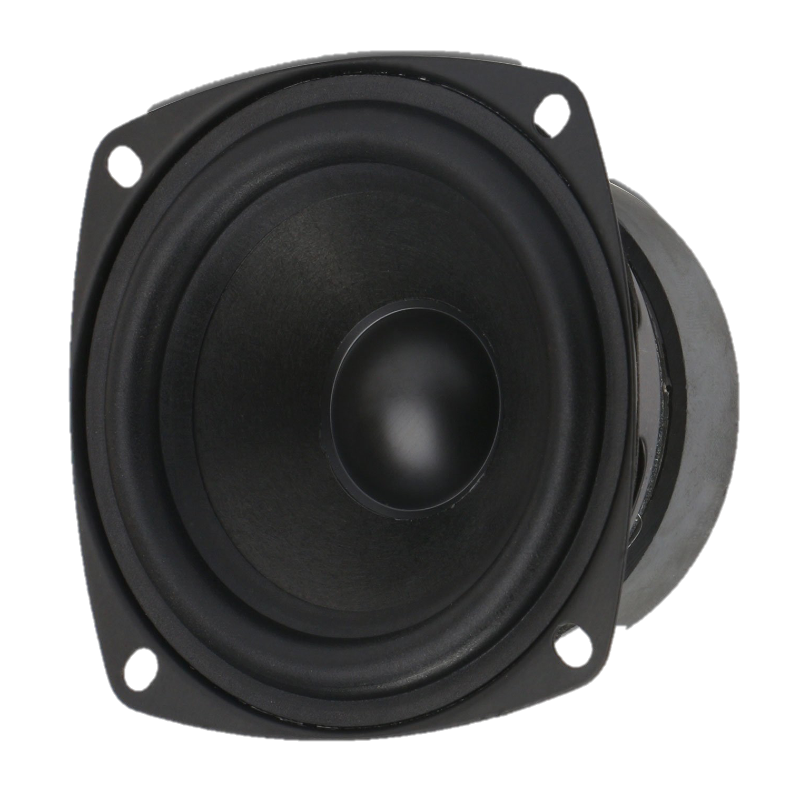
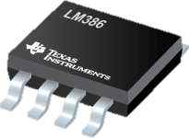
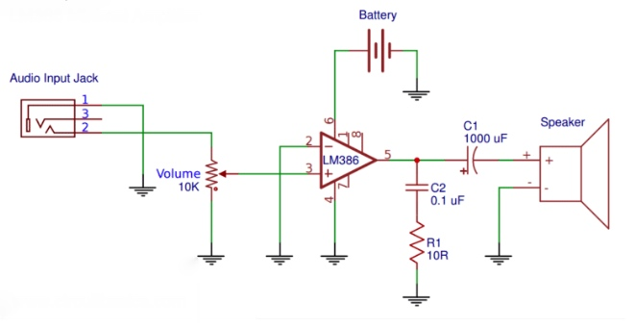
Audio Amplifier & Speakers
9.6 mm
LM386 Audio Amplifier
Voltage gains from 20 to 200
Class AB power amplifier
Low distortion
DROK Speakers
Two 3 inch speakers
Rated power at 15 watts
8 ohms impedance

Slide 21
Software Design
IDE – Arduino Software:
Direct Compatibility with the ATMEGA chips.
Simple, but capable.
Typical Arduino Code Setup:
Header
Setup
Loop
Sub-functions

Slide 22

Software Design
The M6E Nano RFID Reader has an open source library of functions.
Key functions to be used:

Slide 23
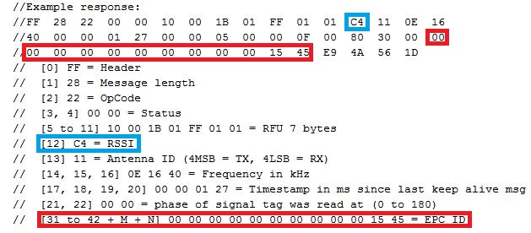
Software Design

Slide 24
Game Board Software Logic Flow
ZigBee: Connection Sync
RFID: Start Reading
Array: Store Data
Initialize
Hard Reset
Hardware Interrupt: Calculate Round Score
Score: Win Condition Met
ZigBee: Transmit Score
ZigBee: Transmit Win

Slide 25
Console Software Logic Flow
Initialize
ZigBee: Connection Sync
Score: Data Received
Array: Store Score
Hard Reset
Physical Input Received
ZigBee: Send Interrupt Signal

Slide 26
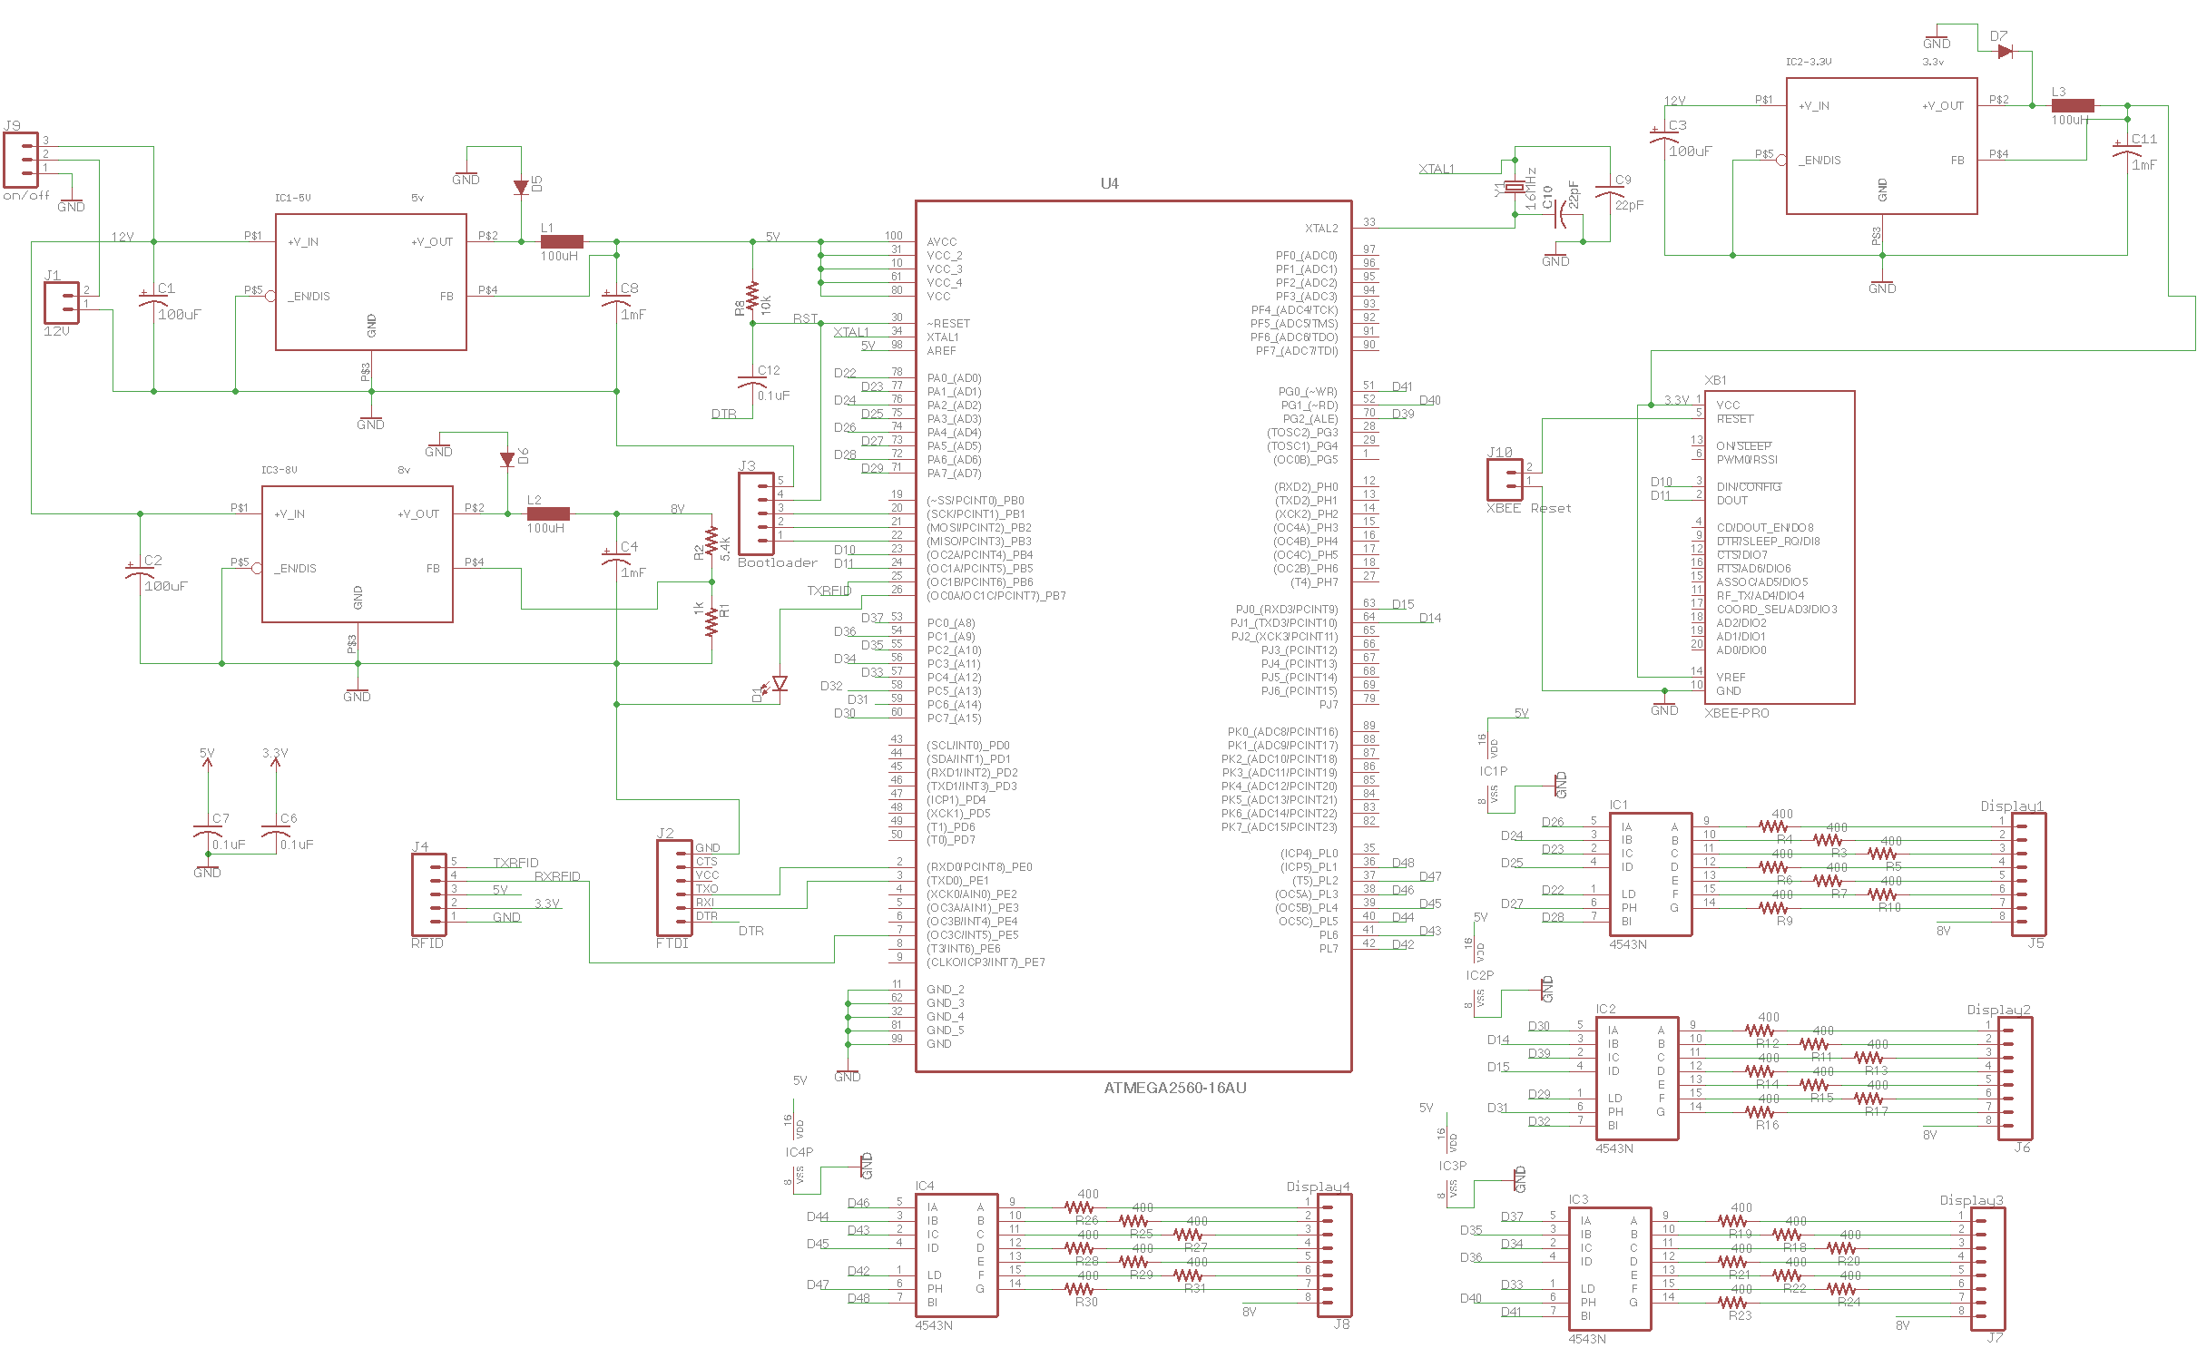
Main PCB Schematics

Slide 27
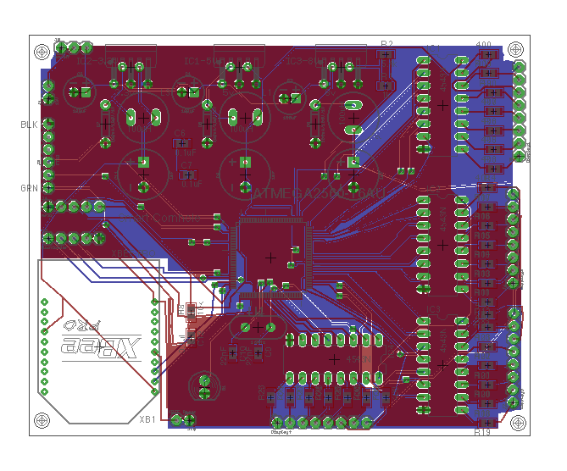
Main PCB Design

Slide 28
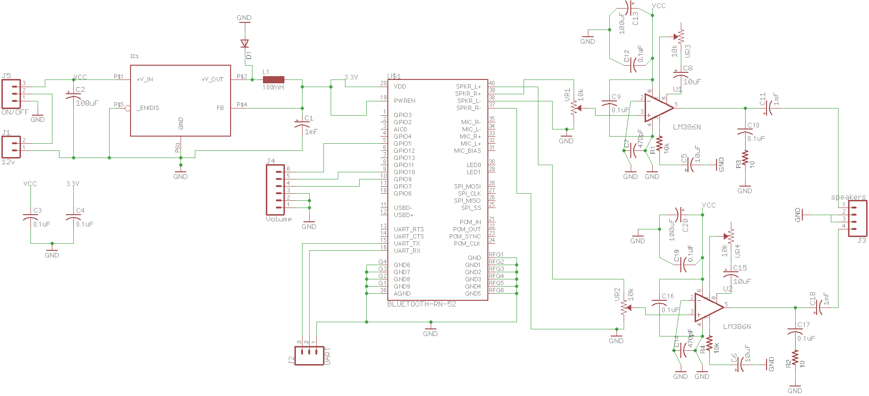
Bluetooth PCB Schematics

Slide 29
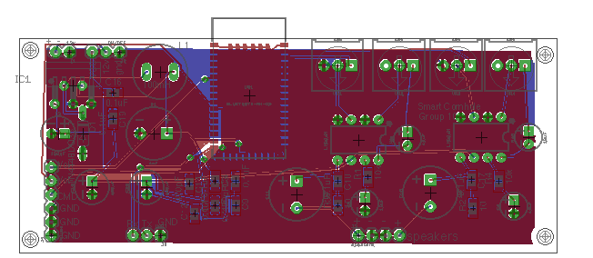
Bluetooth PCB Design

Slide 30
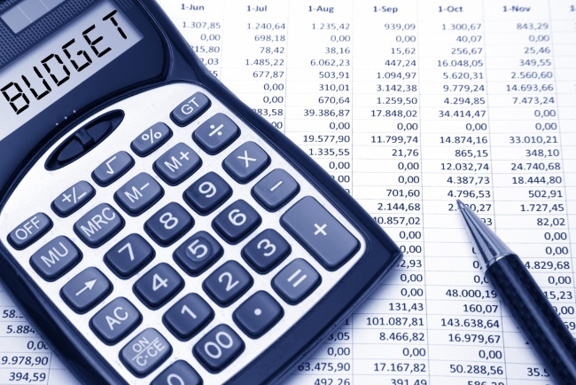
BUDGET
Self-Funded project.
Our goal is to eventually be able to produce this setup at a low cost.
Total cost at about $800 .
Ideally keep total cost under $1,000.

Slide 31
Part Name | Quantity | Cost (Each) | Cost (Total)
Arduino MEGA 2560 Microcontroller | 2 | $35.46 | $70.92
Simultaneous RFID Reader - M6E Nano | 1 | $199.99 | $199.99
400-point Experiment Breadboard | 1 | $6.47 | $6.47
Xbee Shield Module for Arduino | 2 | $11.97 | $23.94
RFID antenna | 1 | $80.00 | $80.00
XBee 1mW Wire Antenna | 2 | $26.95 | $53.90
XBee Explorer USB | 1 | $24.95 | $24.95
7-Segment LCD Displays | 4 | $8.00 | $32.00
Custom PCB | 2 | $30.00 | $60.00
12v Battery | 2 | $25.00 | $50.00
Bluetooth module & Breakout Board | 1 | $44.95 | $44.95
FTDI Basic Breakout 3.3v | 1 | $15.95 | $15.95
FTDI Basic Breakout 5v | 1 | $9.95 | $9.95
3" Speaker | 2 | $3.50 | $12.50
LM1084 Voltage Regulators | 3 | $3.00 | $15.99
LM386 Audio Amps | 2 | $8.00 | $16.00
Xbee Breakout Board | 1 | $4.99 | $4.99
Breakout board for chip | 1 | $30.75 | $30.75
ATMEGA 2560 | 1 | $11.99 | $11.99
Total Cost |  | $765.24 | ≈$800

Slide 32
Work Distribution
Names | Micro-controller | RFID & Antenna | ZigBee | RN52 Bluetooth | Display | PCB | Soldering | Software
Francisco | P | P | S |  |  |  | P
Nihil |  |  | P | S | P | S
Giovanni |  |  |  | P | S | P | S
Alex | S | S | S |  | S |  |  | P

Slide 33
Any Questions?

Slide 34
LETS PLAY!

